Slide 1
Drug Mortality and Socio-Economic conditions in Connecticut
Sandhya Govindaraju, Monica James, Yayun (Aaron) Liu, Alisha Pandhi

Slide 2
Project Description
We were looking to analyze trends in drug overdose death rates in Connecticut by:
Income
Age
Education
Gender
Geo-location (counties)
Unemployment rates
Barriers to medical treatment
Drug

Slide 3
Struggles with data
We were not able to
Drug-induced mortality rates and income
Drug-induced mortality rates and education

Slide 4
Drug-induced mortality rates and age

Slide 5
Drug-induced mortality rates and gender

Slide 6
Drug-induced mortality rates and geo-location (counties)

Slide 7
Drug-induced mortality rates and barriers to medical treatment
Opioid abuse/misuse is at unprecedented levels.
Naloxone (Narcan) is the antidote to an opioid overdose.
AN ACT CONCERNING SUBSTANCE ABUSE AND OPIOID OVERDOSE PREVENTION in 2015
Allowed pharmacists to prescribe opioid antagonists like naloxone. The change was intended to make it easier for relatives or friends of those at risk to have an overdose-reversing drug on hand. In 2015 there were 723 deaths from drug overdoses in Connecticut.
Naloxone Pharmacies in Connecticut (Updated, June 14, 2018)
Source: The Connecticut Open Data Portal: https://data.ct.gov
Source: Connecticut General Assembly: https://www.cga.ct.gov/default.asp

Slide 8
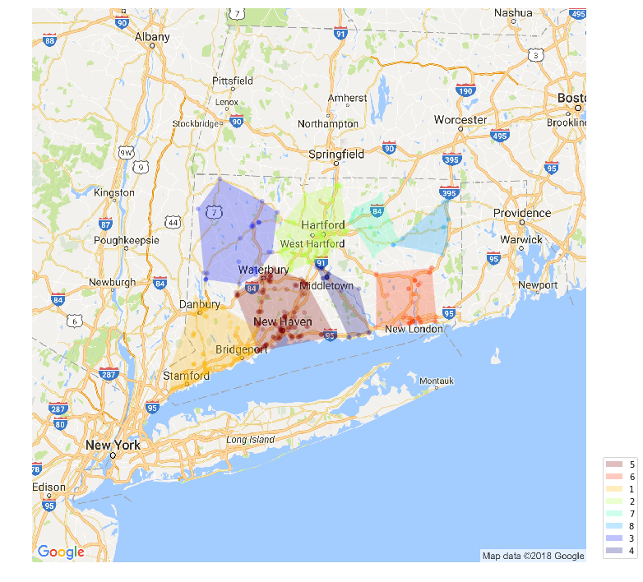
Drug-induced mortality rates and barriers to medical treatment

Slide 9
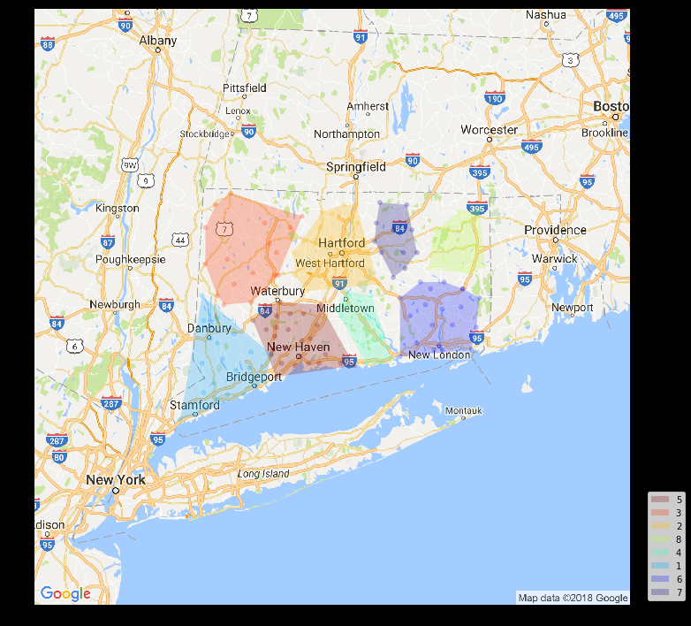
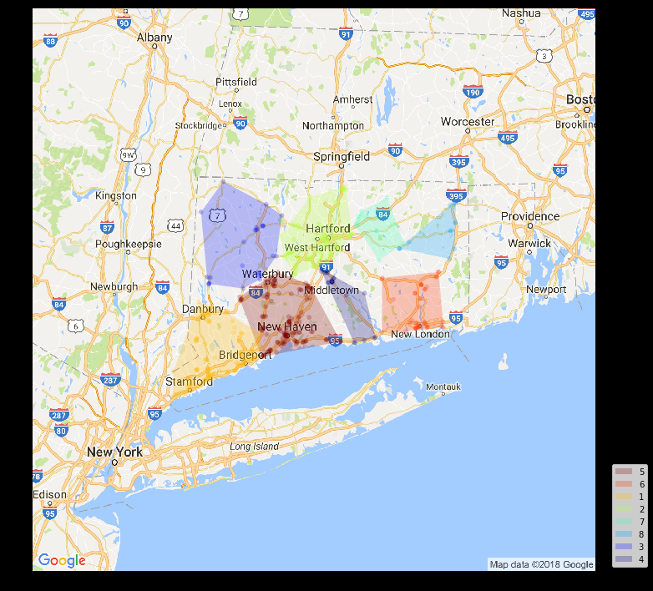
Relationship between deaths (due to opioids overdose) and Naloxone prescribing pharmacies in Connecticut (Deaths (Right) & Pharmacies (Left)

Slide 10
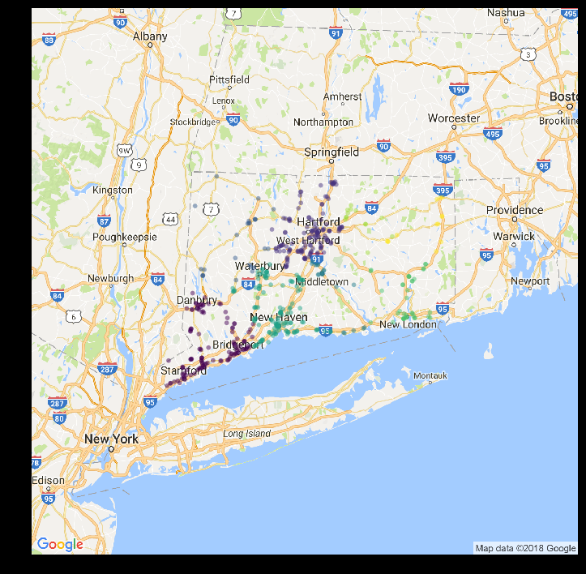
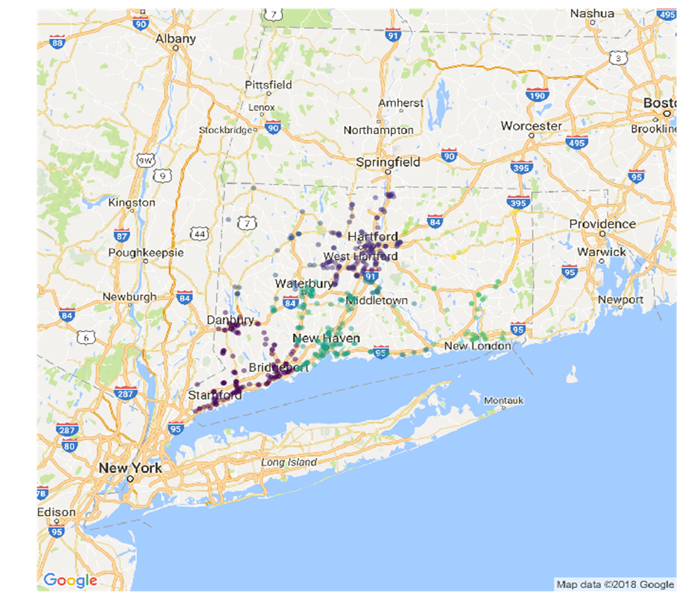
Relationship between Opioids related deaths and Naloxone prescribing pharmacies in Connecticut. (Deaths (Right) & Pharmacies (Left)

Slide 11
Questions?

